Slide 1
ARIMA
ARIMA (AUTOREGRESSIVE INTEGRATED MOVING AVERAGE)
GOAL: CREATE A PREDICTIVE MODEL FOR OPEN STOCK PRICES
TROUBLE: BUILT MODEL TO COLLECT DATA FROM ALL COLUMNS IN ORDER TO PREDICT OPEN PRICE
SOLUTION: ARIMA MODEL FUNCTIONED BETTER WHEN FOCUSING ON ONE COLUMN
MODEL PREDICTS THE FOLLOWING DAY
PREDICTIVE ABILITY: ?!?!?!

Slide 2
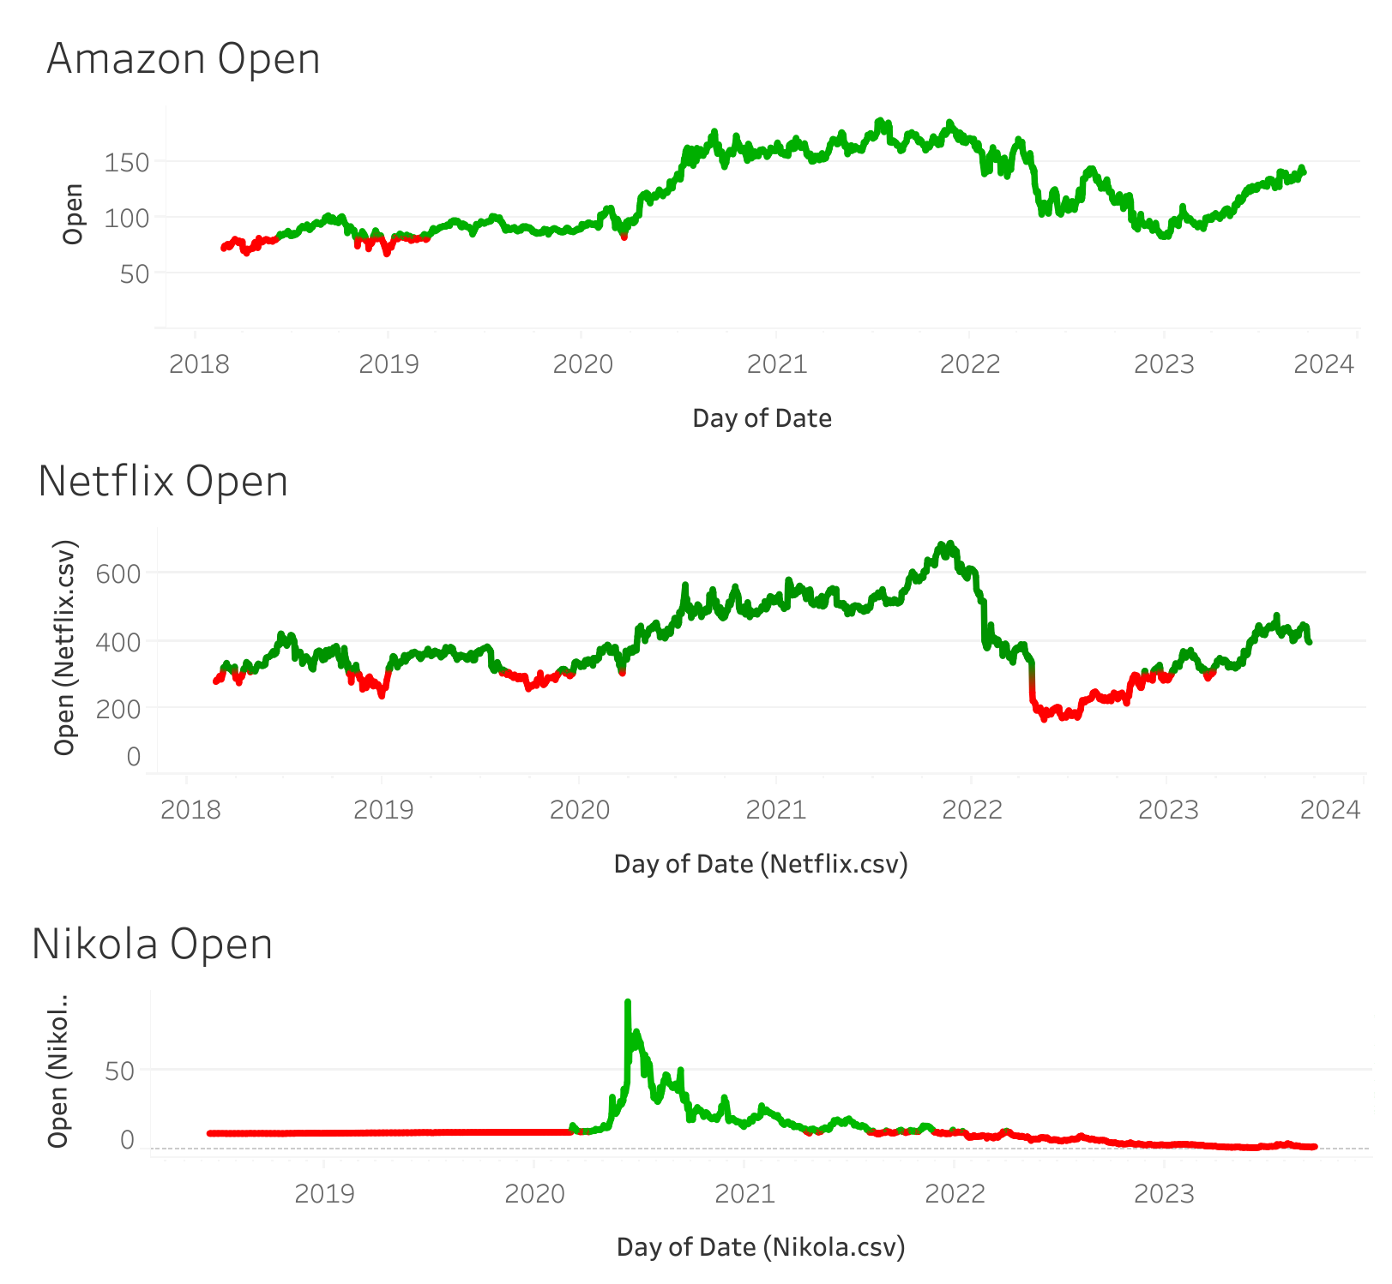
OPEN GRAPHS

Slide 3
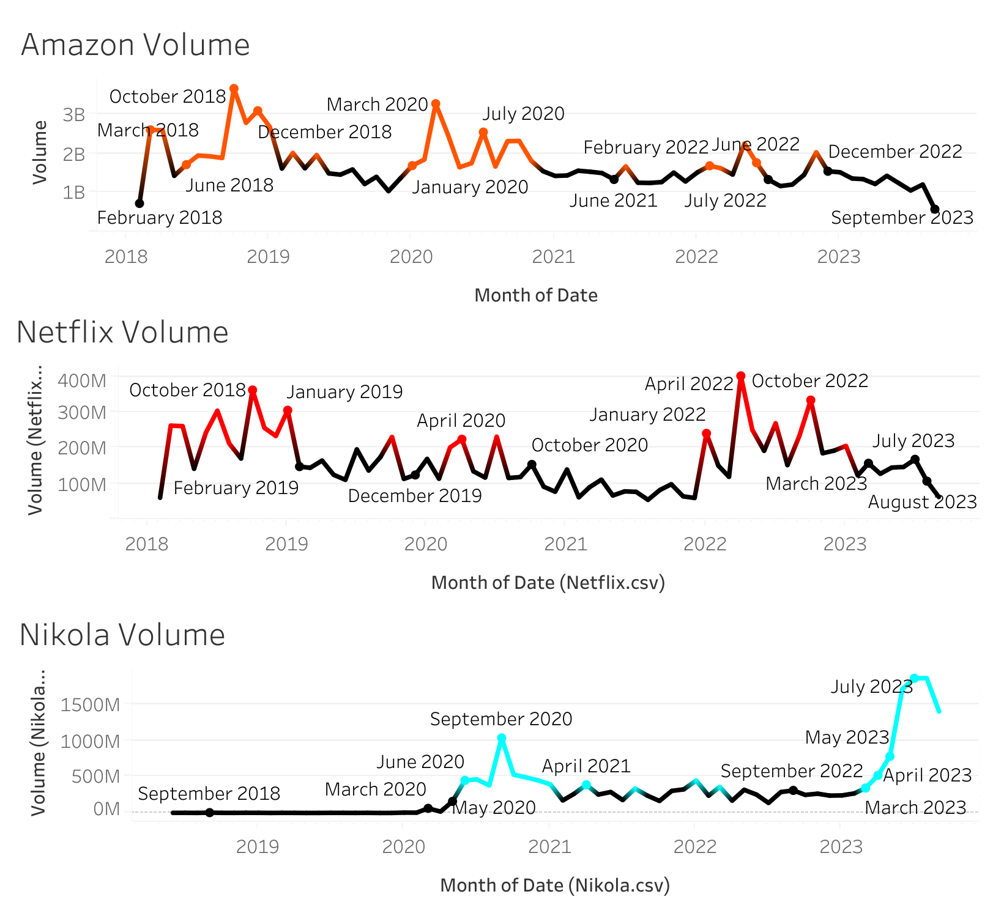
STOCK
VOLUME GRAPHS

Slide 4
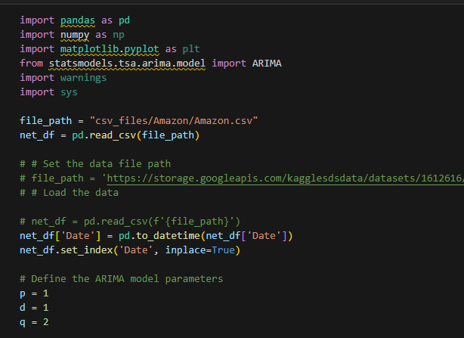

Slide 5
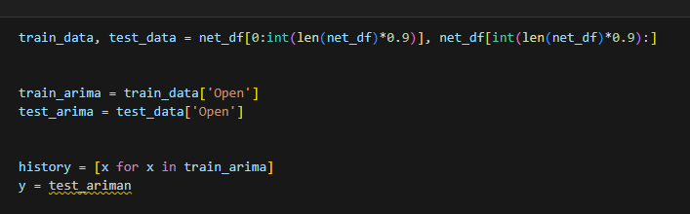


Slide 6
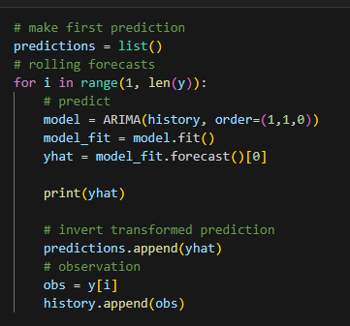

Slide 7
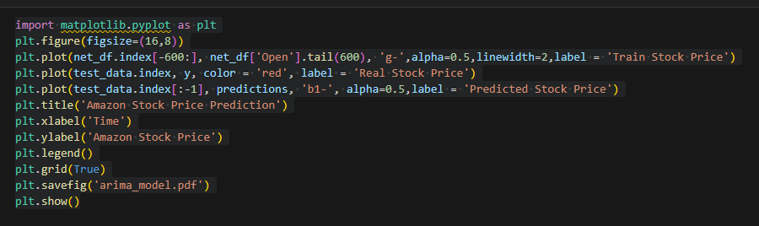
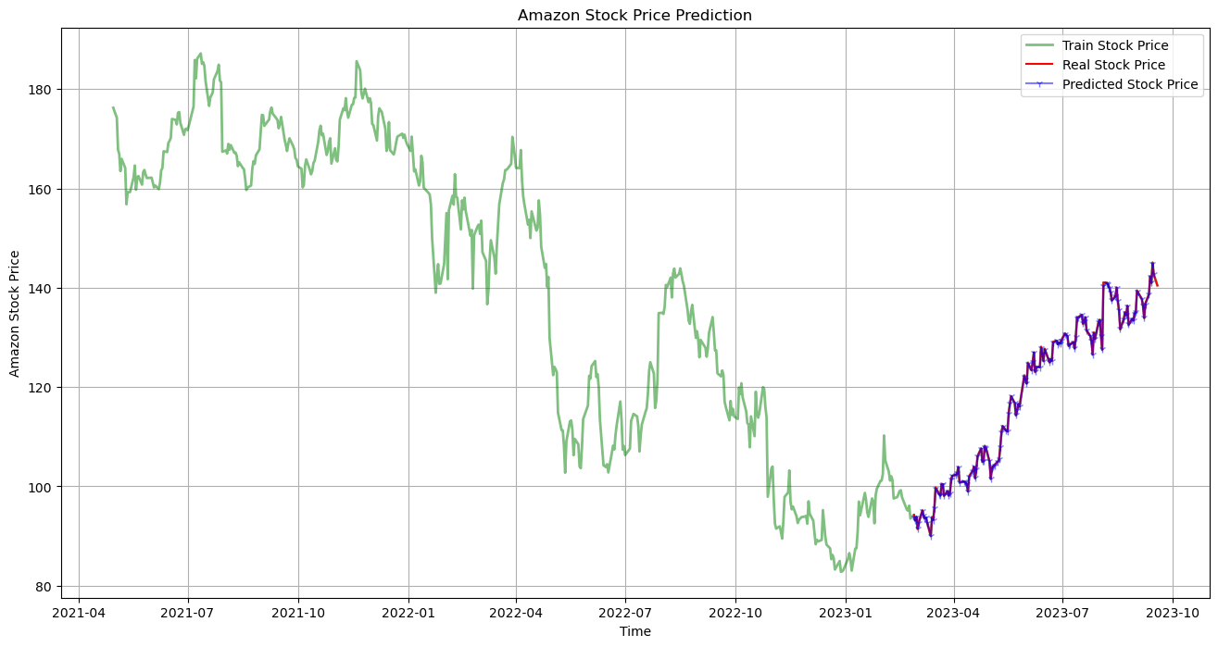

Slide 8
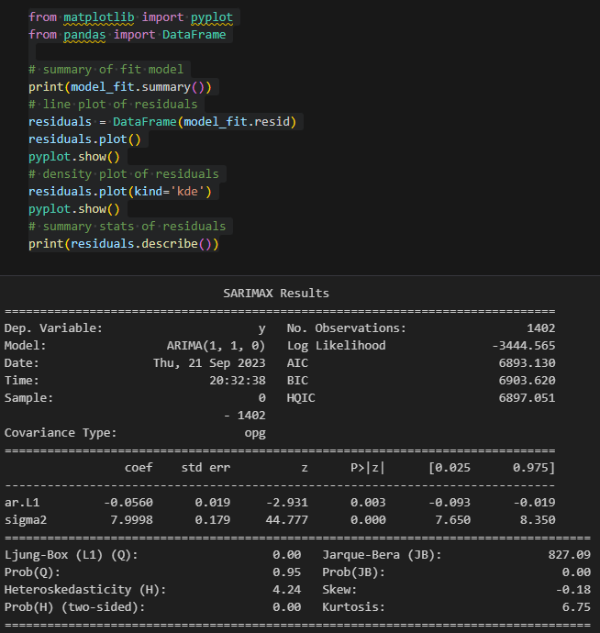

WOW!
SUCH ACCURATE

Slide 9
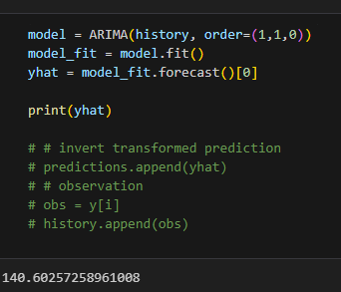
ACTUAL STOCK
PRICE THIS DAY:
140.48

